Slide 1
AIRPORT DELAY ANALYSIS
Aegean Airlines Interview
CHRISTOS LOGARAS

Slide 2
Table of contents
01
02
Data Structure
EDA
03
04
Airport ranking
Delay causality
Summary of dataset, missing values and transformations
Graphical analysis
Airport ranking in terms of delays
Relationship between previous arrival delay and consecutive delay

Slide 3
1.Summary
Rows
Missing
→
Values
Depart. Delay
Delay Reason
Features
Data types
Arrival Delay
Airport info
Dates
5819079 flights
Missing values= cancelled flights
60% of delayed flights without justification
Categorical features added
Float,string,integers
Require transformation to datetime
Missing values= cancelled/diverted flights
9% missing values over flights due to IATA code

Slide 4
1.Missing Values
Airport Info
-Non IATA codes
-Resemble ISO 3166-1 numeric
-Might refer to countries with no latin alphabet.

Slide 5
2.EDA
Flights overview
1,62% cancelled or diverted.
0,182% departure delayed and later diverted/ cancelled.
⇒Customer satisfaction
46% delayed
⇒Airport queuing, productivity.

Slide 6
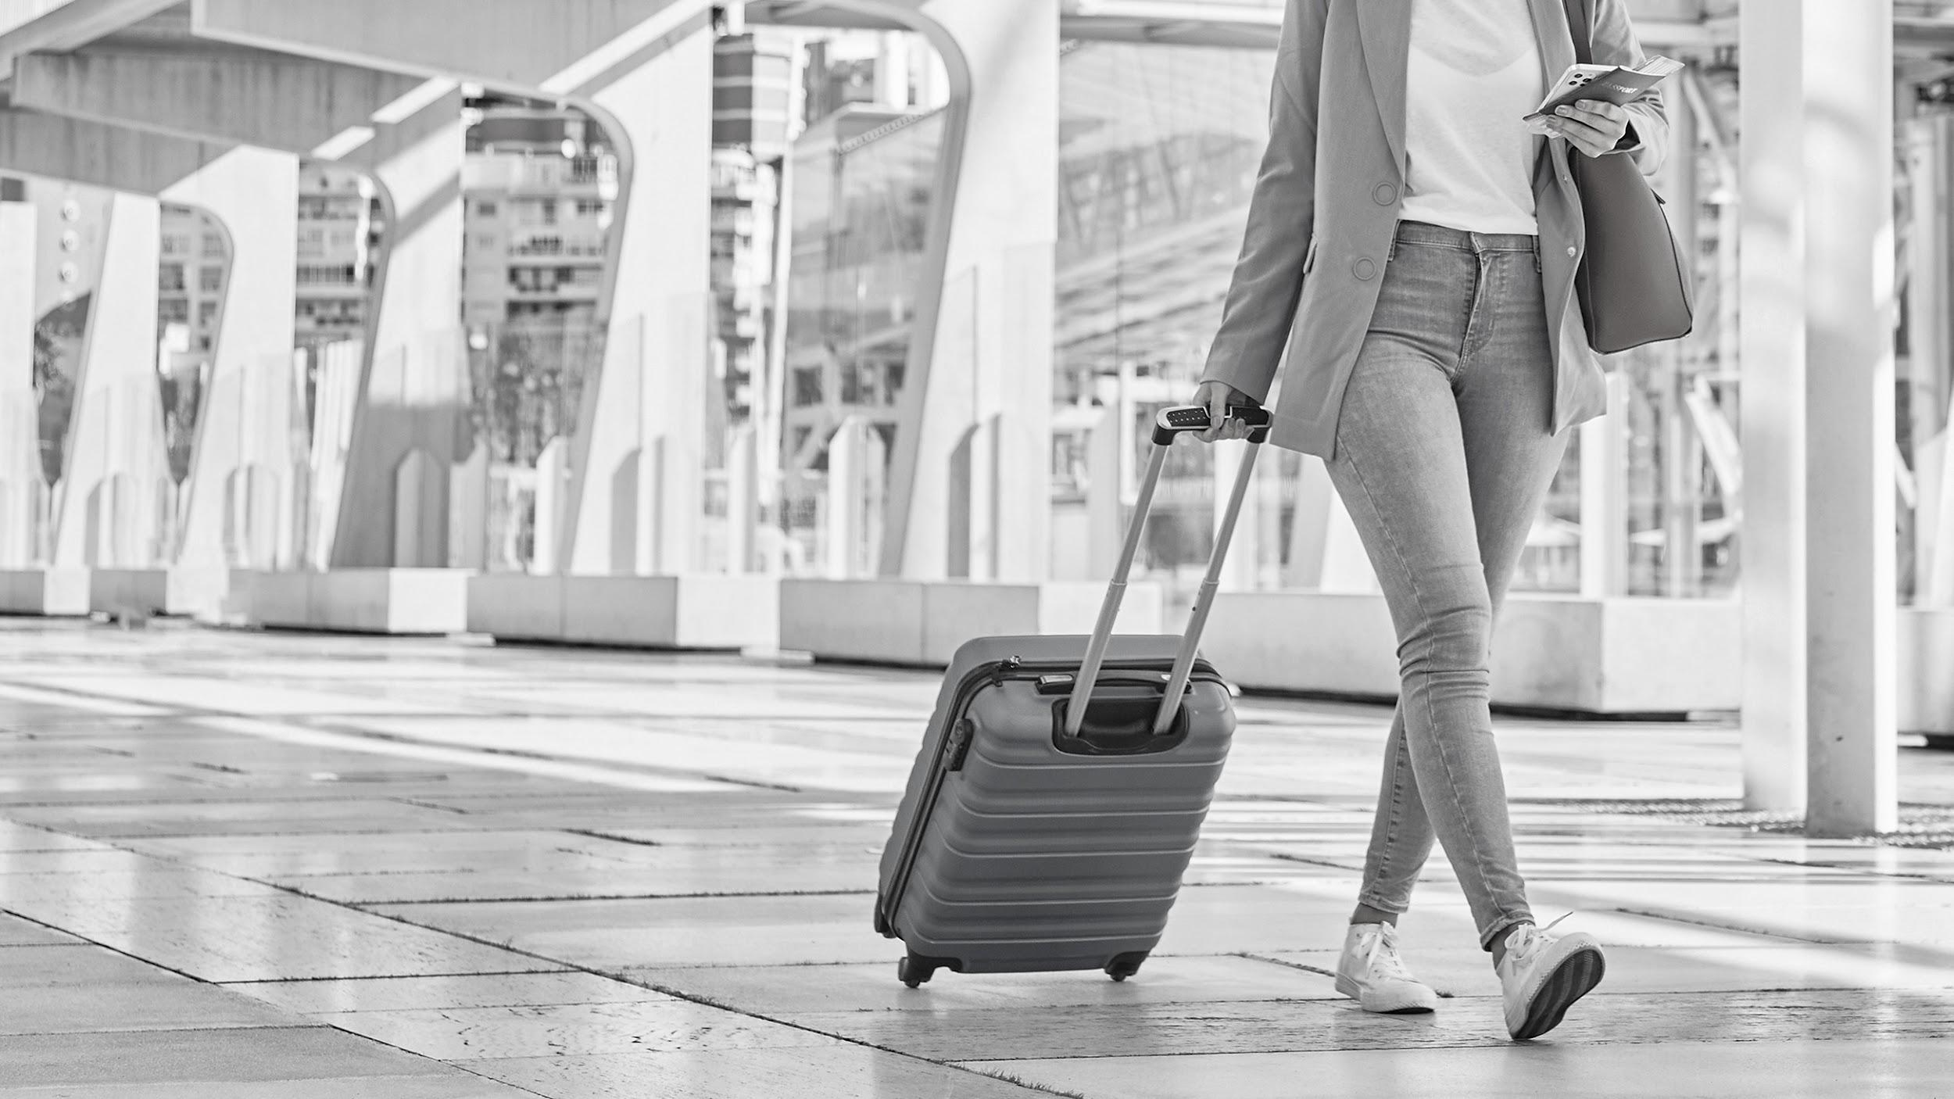
“Punctuality is the key issue in customers satisfaction when it comes to airline services”
“The Impact of Delays on Customers’ Satisfaction: an Empirical Analysis of the British Airways On-Time Performance at Heathrow Airport”

Slide 7
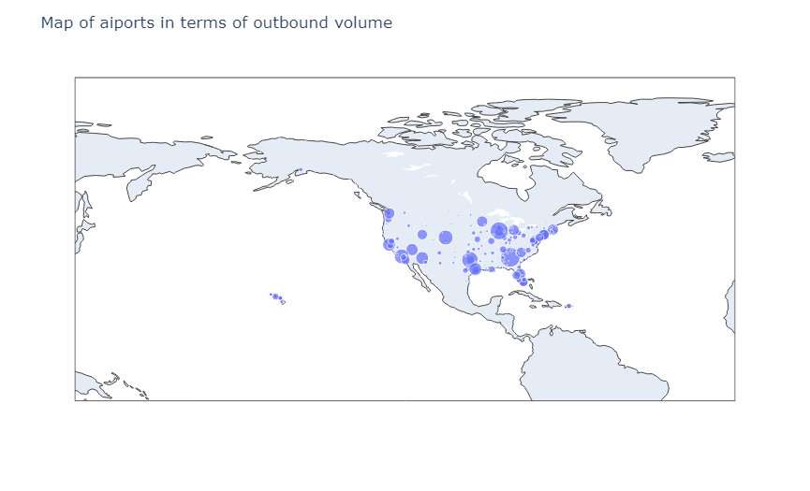
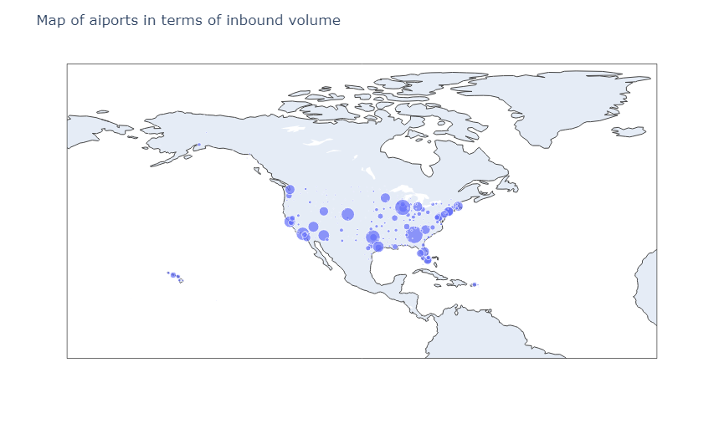
2.EDA
Volume
No significant difference between inbound and outbound, at first glance.

Slide 8
3.Airport Ranking
Sum of delays
Average delay
Median
Taxi-out
Biased towards busy airports
Biased towards small,inefficient non primary or general aviation airports
Result unclear as to internal or external reasons
Established KPI.

Slide 9
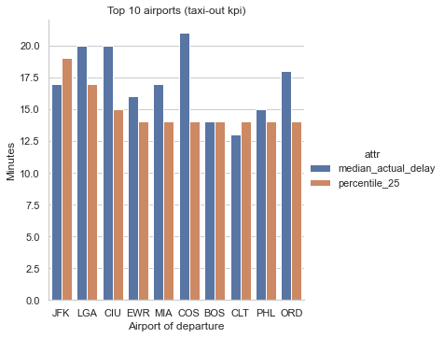
3.Airport Ranking
Departing Airport | Total Volume | %Depart. Delay over 15m | Median departure delay | Percentile_25 (taxi out)
John F. Kennedy | 91663 | 20% | 17 | 19
LaGuardia | 94834 | 22% | 20 | 17
Chippewa County | 596 | 14% | 20 | 15
Newark Liberty | 98341 | 23% | 16 | 14
Miami International | 68301 | 22% | 17 | 14
City of Colorado Springs | 6745 | 15% | 21 | 14
Gen. Edward Lawrence Logan | 104804 | 18% | 14 | 14
Charlotte Douglas | 99052 | 17% | 13 | 14
Philadelphia | 64751 | 18% | 15 | 14
Chicago O'Hare | 276554 | 24% | 18 | 14

Slide 10
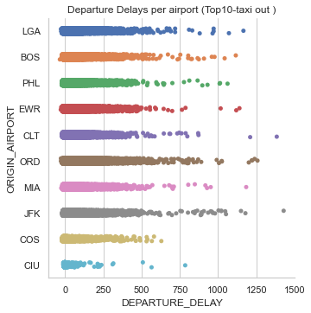
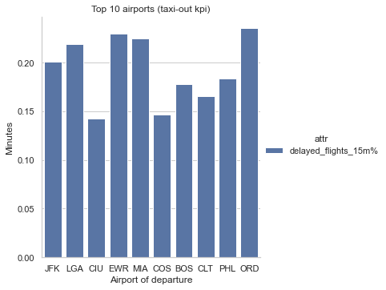
3.Airport Ranking

Slide 11
4.Delay causality
Previews arrival delay(binary)
Arrival delay(binary)
Previews arrival delay
Arrival delay
No strong correlation is found between previous and consecutive arrival delay.
Correlation
0,39
0,46

Slide 12
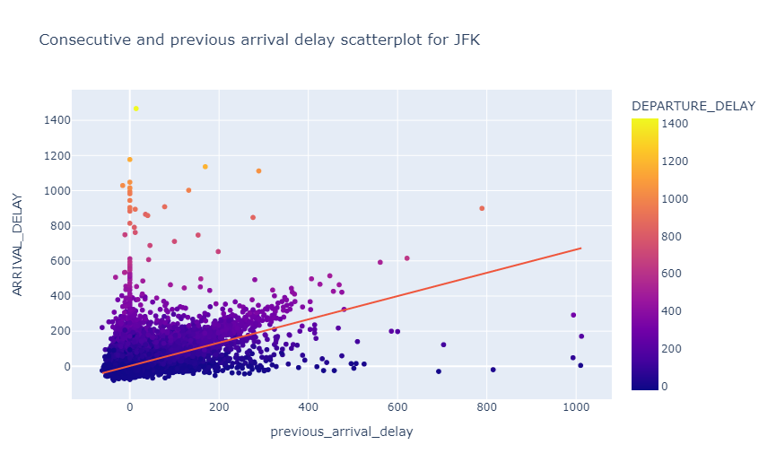
4.Delay causality
DATE | TAIL | Orig. | Dest | Arrival T-1 | Arr. Delay T-1 | Sched. Depart | Time till Depart. | Actual Depart. | Depart. Delay | Actual Arriv. | Arriv. Delay
2/2/15 | N392DA | FLL | JFK | 2/2/15 16:01 | 201.0 | 2/2/15 13:20 | -161.0 | 6:25:00 | 1025.0 | 3/2/15 9:06 | 1010.0
3/2/15 | N392DA | JFK | LAS | 3/2/15 9:06 | 1010.0 | 3/2/15 9:59 | 53.0 | 10:12:00 | 13.0 | 3/2/15 13:05 | 5.0
3/2/15 | N392DA | LAS | SLC | 3/2/15 13:05 | 5.0 | 3/2/15 13:50 | 45.0 | 13:49:00 | -1.0 | 3/2/15 16:04 | -6.0

Slide 13
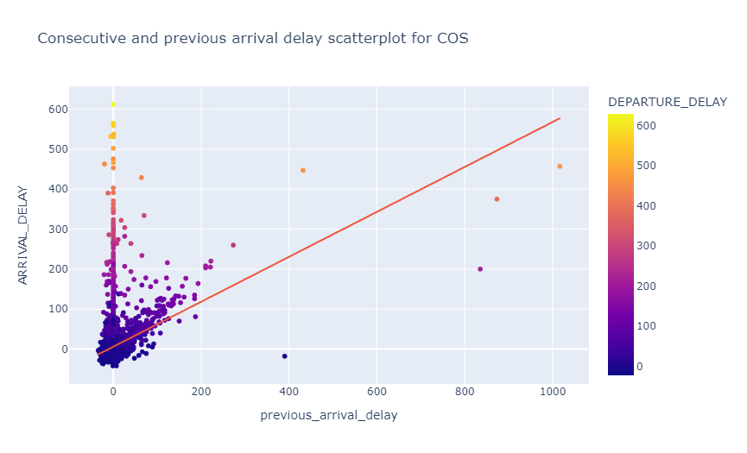
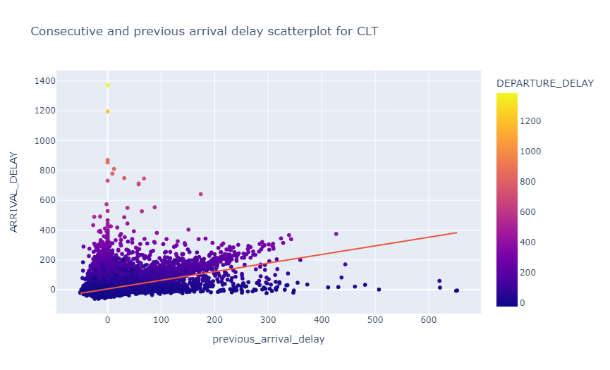
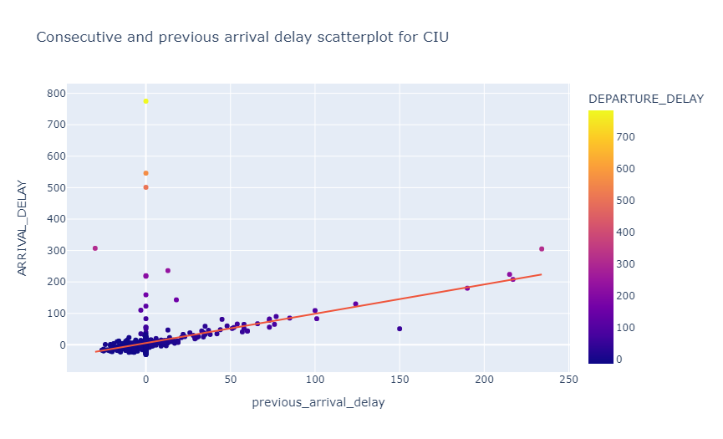
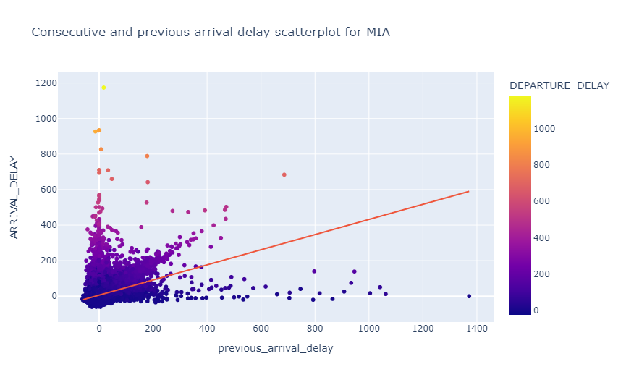
4.Delay causality

Slide 14
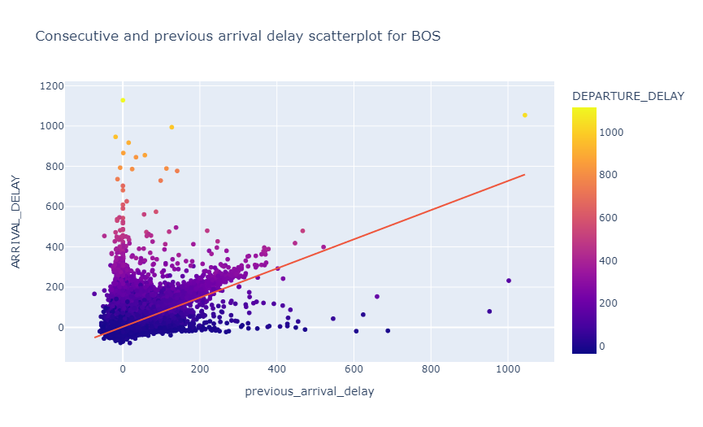
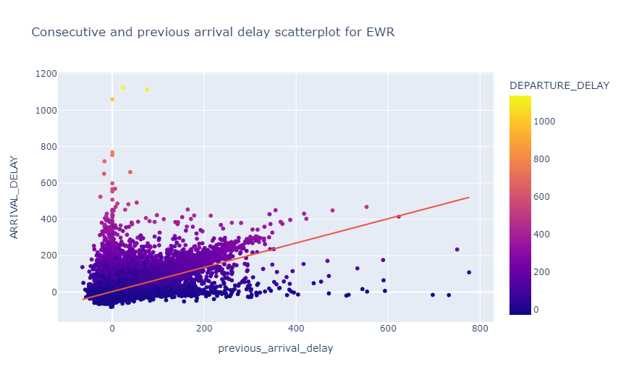

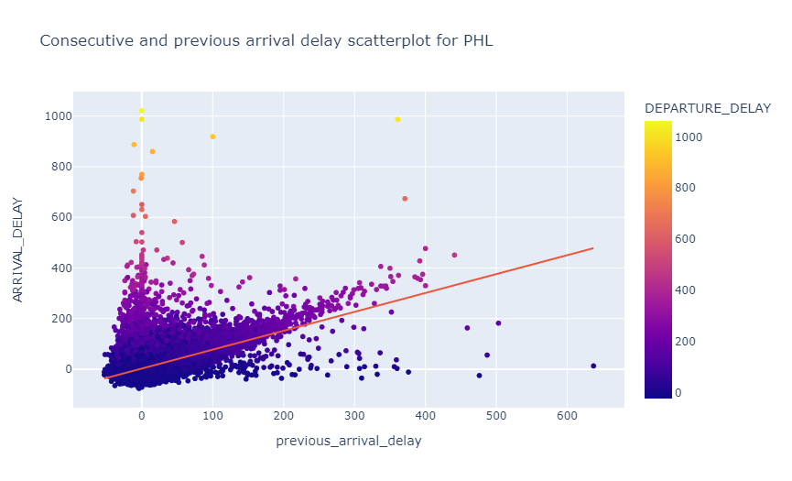
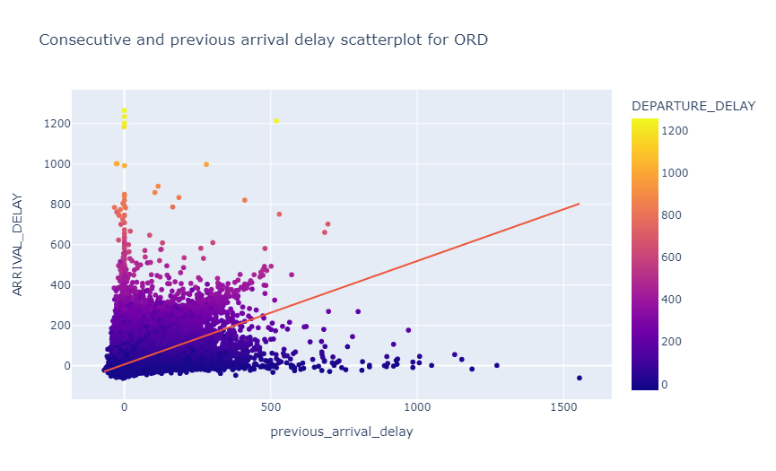
4.Delay causality

Slide 15
4.Delay causality-Regression
OLS rejected null hypothesis but very low R2.
Logit model similarly poor results
Previous arrival is related to consecutive delays, but is not the main factor.
Departure delay has a higher association with arrival delay.
Bivariate
Regression
Analysis
0,21
0,12

Slide 16
4.Delay causality-Next Steps
Previous Arrival
Departure
Consecutive arrival
Turnaround
Flight
Cleaning
Refuel
Supplies
Queue/
Taxi out etc
Speed
Traffic

Slide 17



THANK YOU!
Notes:
Ευχαριστουμε πολυ την big blue για την υποστήριξη
Την bryq για την δυνατοτητα που μας εδωσε να συνεργαστουμε και την slidesgo για τα infographics
Ευχαριστουμε και εσας για την προσοχη σας και θα χαρουμε να απαντήσουμε σε οποιαδηποτε ερωτηση.

